Slide 1
Matrimony Hub
Subscription Page Overview

Slide 2
Project Overview
Matrimony Hub is an online matrimonial website for users seeking life partners.
This presentation covers the subscription page design, features, and technology.

Slide 3
Subscription Plans
1. Basic (₹0): View 10 profiles/day, limited filters, basic support
2. Premium (₹499/month): Unlimited views, contact 10 profiles/month, priority support
3. Elite VIP (₹999/month): Direct chat, profile boost, match priority algorithm

Slide 4
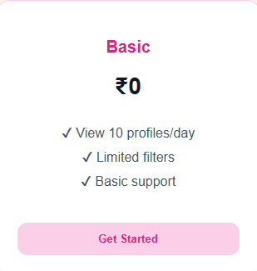
Basic Plan

Slide 5
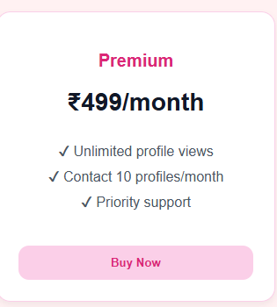
Premium Plan

Slide 6

Elite VIP Plan

Slide 7
Technologies Used
- HTML5
- CSS3
- Tailwind CSS (optional)
- Figma (for design)

Slide 8
Features & Design
- Responsive design with 3 plan cards
- Consistent color theme (pink & white)
- Simple navigation and CTAs
- Footer and branding included

Slide 9
Future Enhancements
- Payment gateway integration
- Backend subscription tracking
- Plan highlighting animations
- Personalized plan options

Slide 10
Thank You
Project by: Rohit Mewada
© 2025 Matrimony Hub

